Slide 1


“Fingerprint Based Attendance System using Arduino”
|| न हि ज्ञानेन सदृशं पवित्रमिह विद्यते || Dr. Vitthalrao Vikhe Patil Foundation's Dr. Vithalrao Vikhe Patil College of Engineering, Ahilyanagar
DEPARTMENT OF
ELECTRONICS & TELECOMMUNICATION ENGINEERING
Guided By: Dr. A. R. Landge
Group Members
1.Ashwini Patare
2.Tanvi Kodam
3.Vaishnavi Jagtap

Slide 2
|| न हि ज्ञानेन सदृशं पवित्रमिह विद्यते || Dr. Vitthalrao Vikhe Patil Foundation's Dr. Vithalrao Vikhe Patil College of Engineering, Ahilyanagar
Project Description :
The Fingerprint Based Attendance System is an IoT-based smart attendance project designed to automate the process of student attendance using biometric fingerprint authentication with an ESP32 microcontroller.
The system uses an R307 fingerprint sensor to accurately identify students, an I2C LCD display to show system status and attendance details, an RTC module for real-time date and time tracking, and push buttons for subject selection, enrollment, and system control.
Whenever a student scans their fingerprint, the system verifies the fingerprint ID, marks attendance automatically, and uploads the student ID, name, subject, date, time, and attendance status to Google Sheets through Wi-Fi connectivity.
Separate subject-wise attendance sheets such as PDC, CN, EP, and PM are maintained for organized record management and easy monitoring of attendance data.

Slide 3
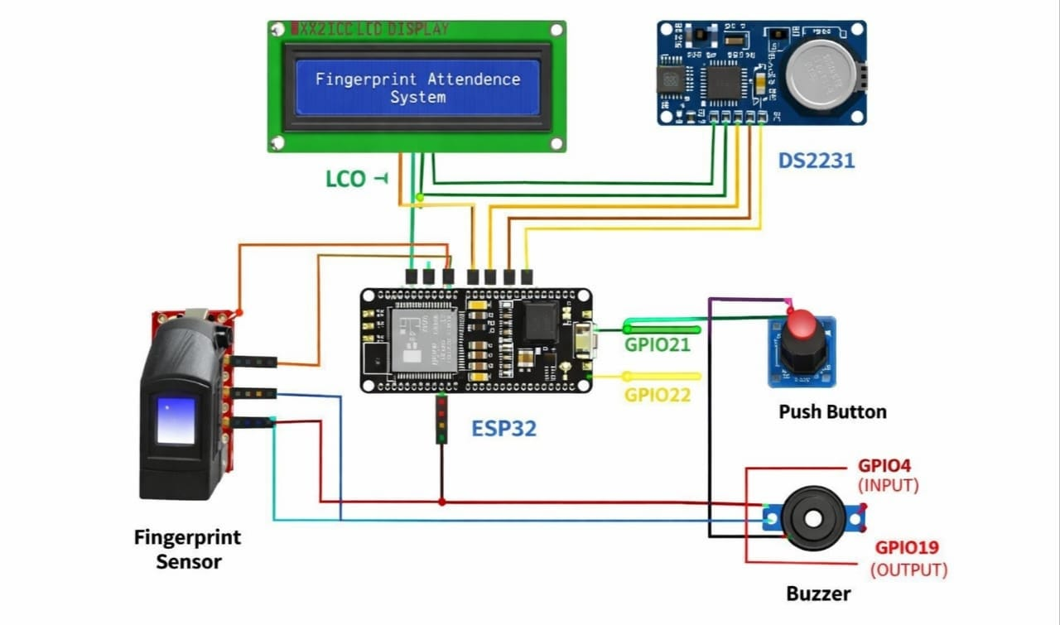
|| न हि ज्ञानेन सदृशं पवित्रमिह विद्यते || Dr. Vitthalrao Vikhe Patil Foundation's Dr. Vithalrao Vikhe Patil College of Engineering, Ahilyanagar
Circuit Diagram:-

Slide 4
|| न हि ज्ञानेन सदृशं पवित्रमिह विद्यते || Dr. Vitthalrao Vikhe Patil Foundation's Dr. Vithalrao Vikhe Patil College of Engineering, Ahilyanagar
Components Used list with Specification & Cost.
ESP32 Microcontroller
ESP32 is the main controlling unit of the project.
It provides built-in Wi-Fi and Bluetooth features.
It processes fingerprint data and controls all modules.
It sends attendance data to Google Sheets through internet connection.
It is used because it supports IoT applications with high speed and low power consumption.
Approximate cost: ₹450.

Slide 5
|| न हि ज्ञानेन सदृशं पवित्रमिह विद्यते || Dr. Vitthalrao Vikhe Patil Foundation's Dr. Vithalrao Vikhe Patil College of Engineering, Ahilyanagar
2. RTC module
DS3231 is a Real Time Clock module.
It provides current date and time to the system.
It maintains time even when power is disconnected.
It improves attendance record accuracy.
It is used for proper attendance timing and timestamp generation.
Approximate cost: ₹150.

Slide 6
|| न हि ज्ञानेन सदृशं पवित्रमिह विद्यते || Dr. Vitthalrao Vikhe Patil Foundation's Dr. Vithalrao Vikhe Patil College of Engineering, Ahilyanagar
3.Fingerprint sensor
R307 is a biometric fingerprint recognition module.
It captures, stores, and matches fingerprint data.
It helps in secure and automatic attendance marking.
It provides fast and accurate fingerprint verification.
It is used to avoid fake or proxy attendance. Approximate cost: ₹1000.

Slide 7
|| न हि ज्ञानेन सदृशं पवित्रमिह विद्यते || Dr. Vitthalrao Vikhe Patil Foundation's Dr. Vithalrao Vikhe Patil College of Engineering, Ahilyanagar
4.I2C LCD Display
16×2 I2C LCD is used for displaying information.
It shows subject name, time, and attendance status.
It requires fewer wiring connections because of I2C interface.
It provides an easy user interaction system.
It is used for live monitoring and system messages. Approximate cost: ₹250.

Slide 8
|| न हि ज्ञानेन सदृशं पवित्रमिह विद्यते || Dr. Vitthalrao Vikhe Patil Foundation's Dr. Vithalrao Vikhe Patil College of Engineering, Ahilyanagar
5.Buzzer
Buzzer is an audio output device used in the project.
It gives sound indications for system operations.
It alerts for successful and failed fingerprint scans.
It improves user response and notification system.
It is used for instant audio feedback during attendance marking.
Approximate cost: ₹30.

Slide 9
|| न हि ज्ञानेन सदृशं पवित्रमिह विद्यते || Dr. Vitthalrao Vikhe Patil Foundation's Dr. Vithalrao Vikhe Patil College of Engineering, Ahilyanagar
Use of your Model :
Automatic attendance marking using fingerprint.
Reduces proxy attendance and cheating.
Saves teacher’s time during attendance.
Stores attendance records digitally. Provides fast and accurate identification.
Easy to use in schools, colleges, and offices.
Reduces paperwork and manual errors.
Attendance can be monitored in real time.

Slide 10
|| न हि ज्ञानेन सदृशं पवित्रमिह विद्यते || Dr. Vitthalrao Vikhe Patil Foundation's Dr. Vithalrao Vikhe Patil College of Engineering, Ahilyanagar
Advantages of Project:
Prevents fake or proxy attendance.
Saves time compared to manual attendance.
Easy and fast attendance process.
Reduces human errors in attendance records.
Less paperwork and maintenance.
Disadvantages of Project:
Fingerprint sensor may fail due to dirty or wet fingers.
Initial setup cost is higher than manual attendance.
Hardware damage can stop the attendance process.
Slow performance if database becomes very large.
Fingerprint matching errors may occur sometimes.

Slide 11
|| न हि ज्ञानेन सदृशं पवित्रमिह विद्यते || Dr. Vitthalrao Vikhe Patil Foundation's Dr. Vithalrao Vikhe Patil College of Engineering, Ahilyanagar
Future Scope :
Face recognition can be added with fingerprint authentication.
Real-time attendance analytics and reports.
Wireless and faster IoT communication features.
Multi-user and multi-classroom support.
Automatic monthly attendance report generation.
Mobile app support for teachers and administrators.

Slide 12
Thank You

